Slide 1
BRIDGE EXPANSION JOINT

Slide 2
INTRODUCTION
Generally Expansion Joints of Bridges are designed to provide continuity between two parts of the structures which are in relative movements because of thermal deformation, creep, shrinkage and displacement/deflection of the structures under traffic load. Expansion Joints should be capable of accommodating all movements of the deck slab.

Slide 3
TYPE OF EXPANSION JOINT BASED ON MOVEMENT
Small Movement Joints: capable of accommodating total motion up to
45 mm.
Medium Movement Joints: capable of accommodating total motion 45 mm to 130 mm.
Large Movement Joints: capable of accommodating total motion excess of 130 mm.

Slide 4
TYPE OF SMALL MOVEMENT JOINT
(Based On Construction)
Sliding Plate joints
Compression Seal Joints
Asphaltic Plug Joints
Poured Sealant Joints

Slide 5

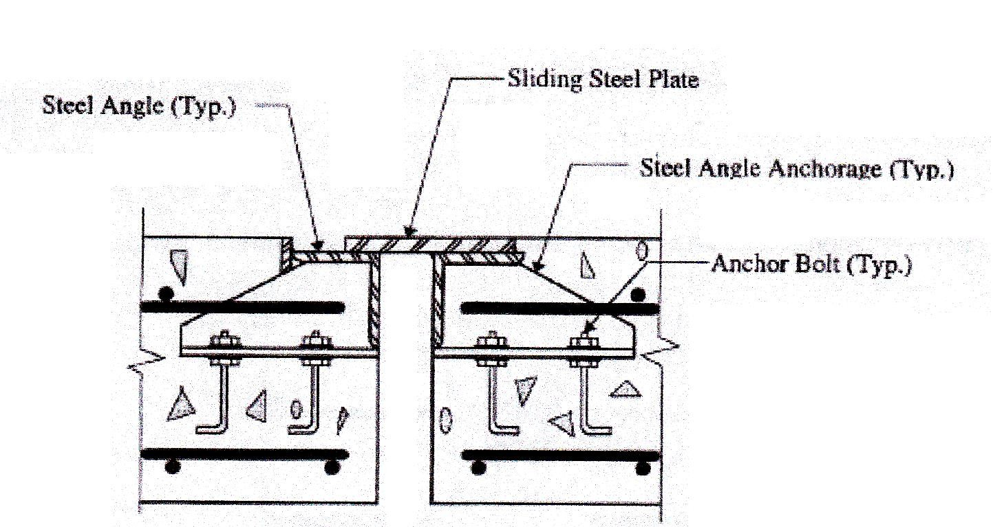
SLIDING PLATE JOINT
Advantages:
Sliding Plate Joints are used for short and medium span bridges.
These Joints are structurally simple, reasonable in cost.
Disadvantages:
These are limited to horizontal movement and there would be no differential vertical movement.
Plates need to be adjusted periodically to reduce noise level.
The corrosion of plates and debris collected may result in jamming of the joint preventing the free movement of superstructure.

Slide 6

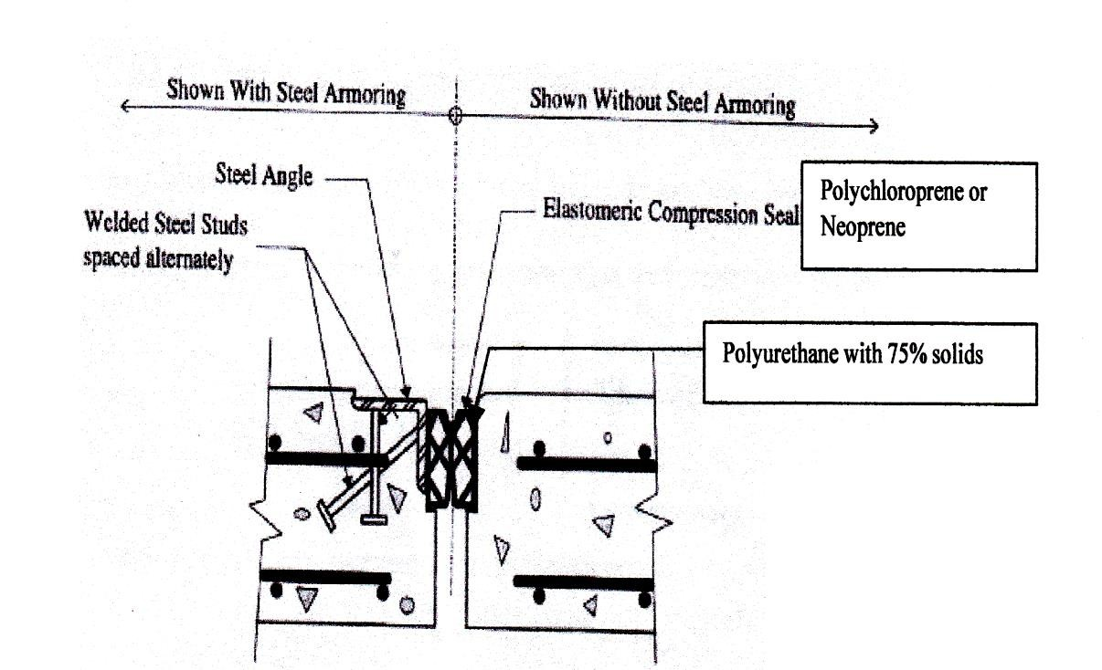
COMPRESSION SEAL JOINT
Advantages: These seals are versatile, relatively inexpensive and easy to replace.
Disadvantages:
For wider joints, adherence of the seal to the sides of the joint throughout the length is difficult.
Not suitable for deck slab with a large skew and
curvature.

Slide 7
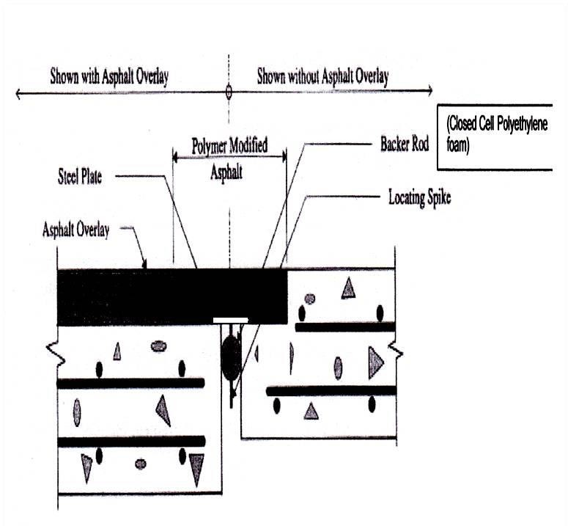
ASPHALTIC PLUG JOINT
Advantages:
They provide smooth roadway surface for traffic.
They are water tight and snow proof.
There is no debris collection at the top of the joint.
Disadvantages:
Not suitable in cold areas where lowest temperature is below Transition temperature of APJ material.
Generally limited to the skew angle below 30
degrees.
3. Can not
accommodate differential vertical
displacement.

Slide 8

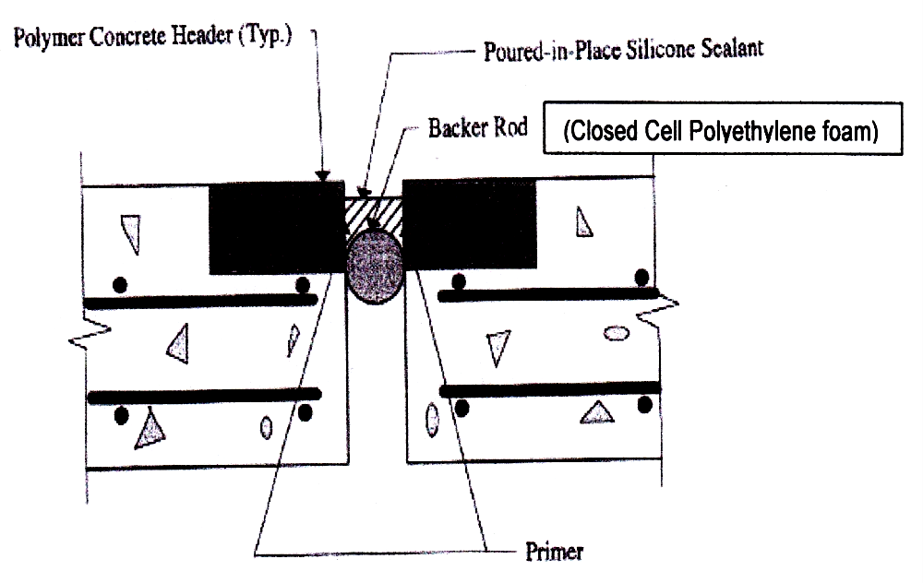
POURED SEALANT JOINT
Advantages:
Easy to use and self leveling.
Can be placed in a short time so suitable for rehabilitation/repair project.
Exhibit good elastic properties over a wide range of temperature variation.
Disadvantages:
It’s a temporary type of joint system(8-10 years) and mainly used for bridge rehabilitation projects where it is difficult to replace existing seals.
Very sensitive to field installation conditions, such as
workmanship.

Slide 9
TYPE OF MEDIUM MOVEMENT JOINT
(Based On Construction)
Strip Seal joints
Finger Plate Joints

Slide 10

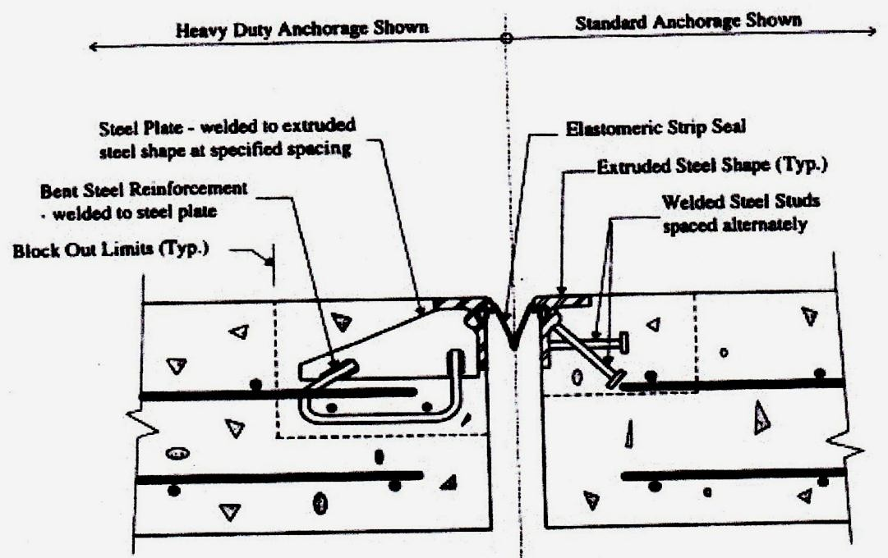
STRIP SEAL JOINT
Advantages:
Properly installed strip seals have demonstrated
relatively good performance.
Damage seals can be replaced with minimum traffic disruptions.
Disadvantages:
1. Accumulates
debris which can resist joint
movement and result in a premature seal failure.
2. Faulty installations or unclean locking devices cause seal pullout from metallic rail edges.

Slide 11

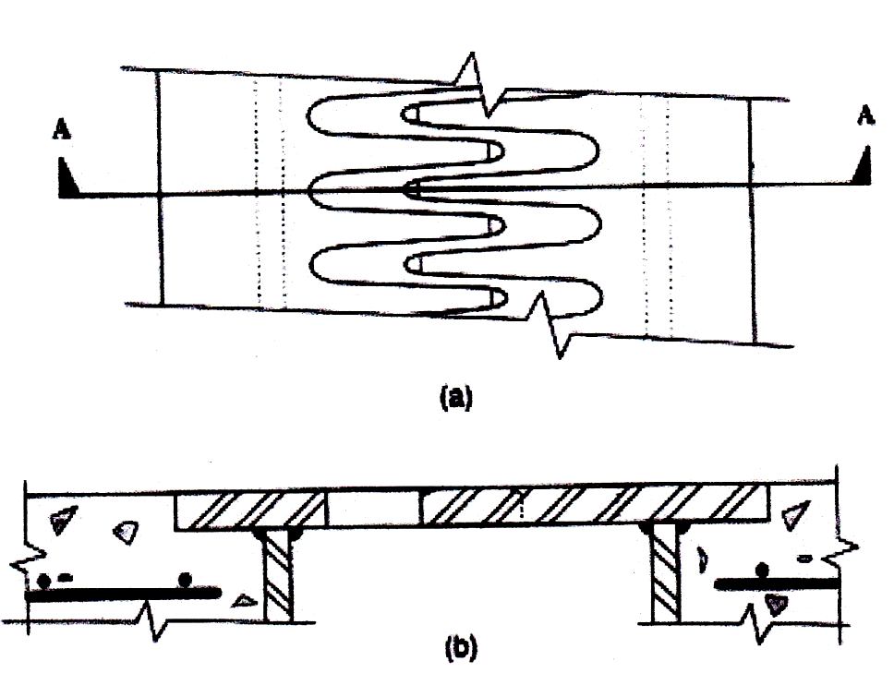
FINGER PLATE JOINT
Advantages:
It can accommodate all movements of the structure both horizontal and vertical.
Successfully used in medium and long span bridges.
It has a good riding quality without causing any hazards to any class of road users.
Silent and skid & vibration free in operation.
It allows easy inspection, maintenance, repair or
replacement.
Disadvantages: Finger Plate joints allow water and de- icing chemical to pass through them. Elastomeric or metallic seal must be placed beneath them to intercept the deck water and debris way from the substructure member.

Slide 12
TYPE OF LARGE MOVEMENT JOINT
(Based On Construction)
Bolt-Down Panel Joints
Modular Elastomeric Seal Joints

Slide 13

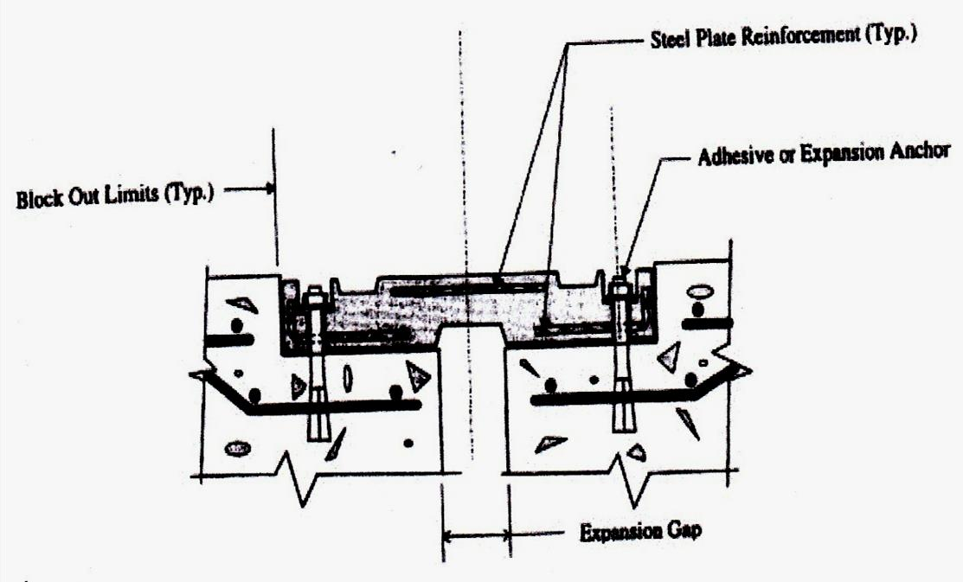
BOLT-DOWN JOINT
Advantages: Bolt-down panels can be fabricated in varying widths proportional to the total allowable movement range.
Elastomeric dam
Disadvantages: Bolts and nuts connecting panel to bridge decks are prone to loosening and breaking under high speed traffic. The loose panels and hardware in the roadway present hazards to vehicular traffic, particularly to motorcycles.

Slide 14
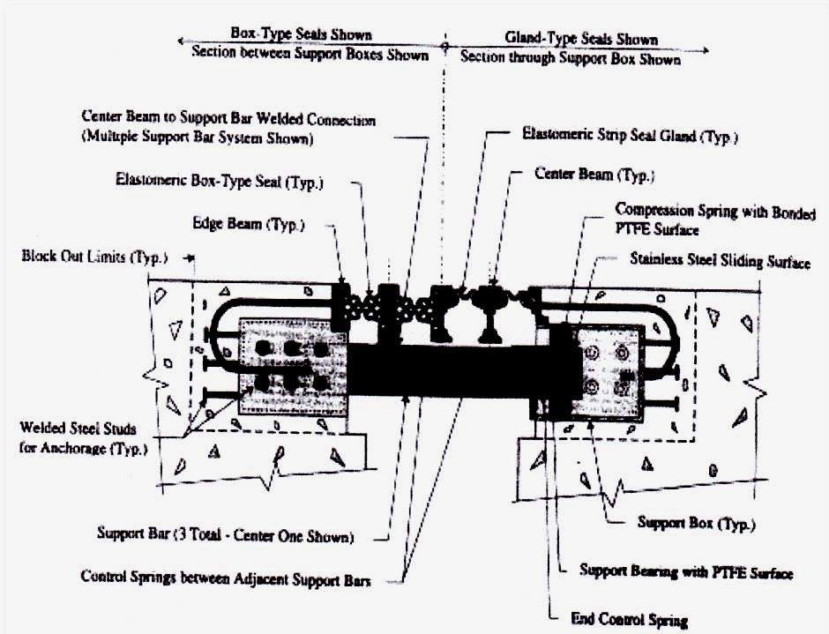
MODULAR ELASTOMERIC SEAL JOINT
Advantages: These joints provide watertight and vehicular load transfer across a wide expansion joint openings and performance of these joints at many locations have been found satisfactory.
Disadvantages: These devices are structurally complex and very expensive.

Slide 15
INSTALLATION STEPS WITH PICTORAL VEIW

Slide 16



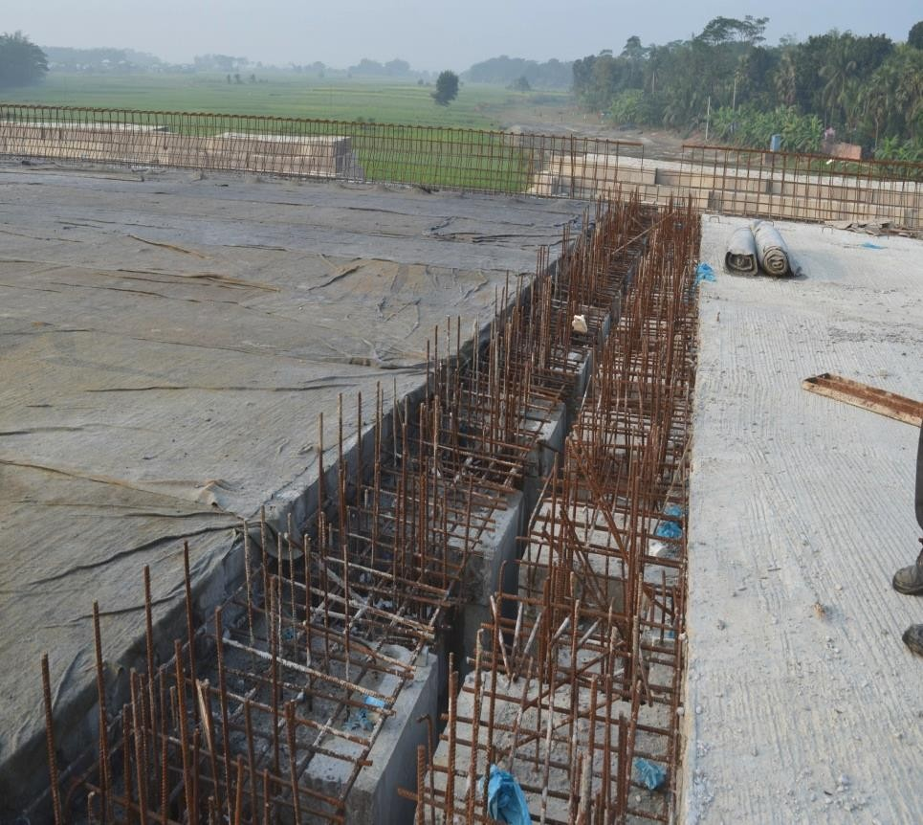
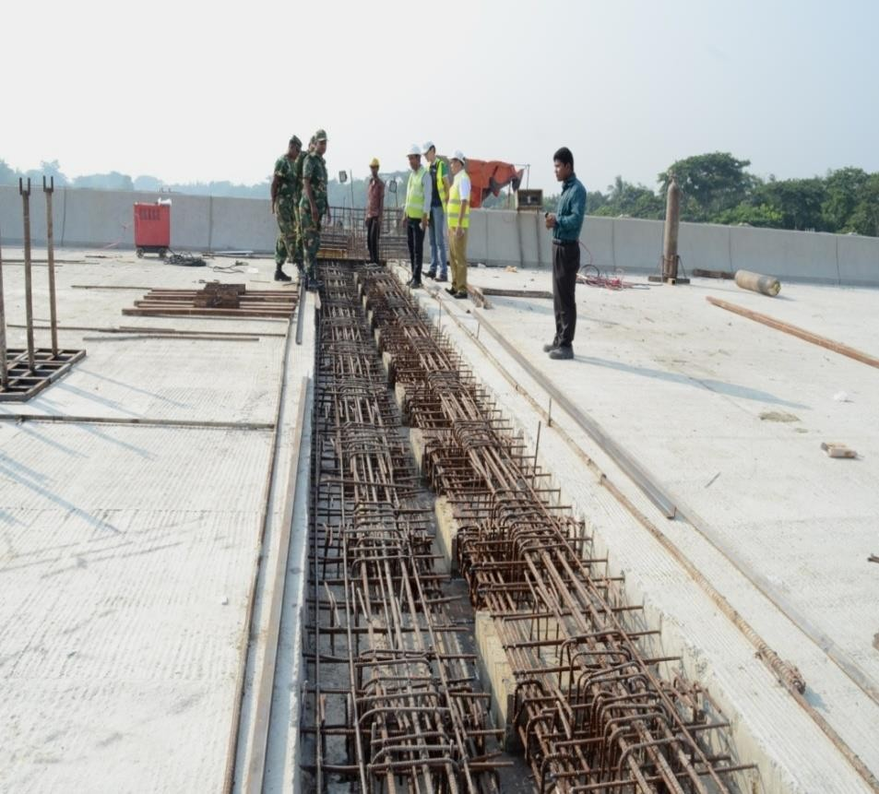
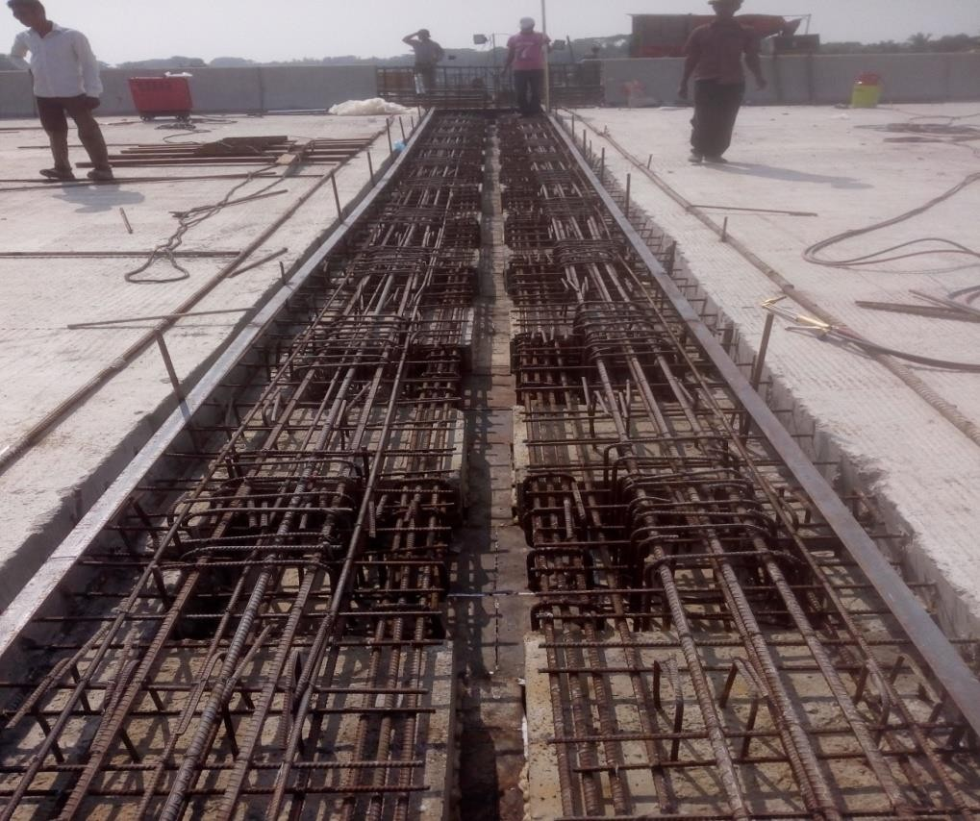


Reference Beam
Reference Beam
Block-out area after deck slabs concreting
Prepare the Block-out area
Reference Beam Installation

Slide 17


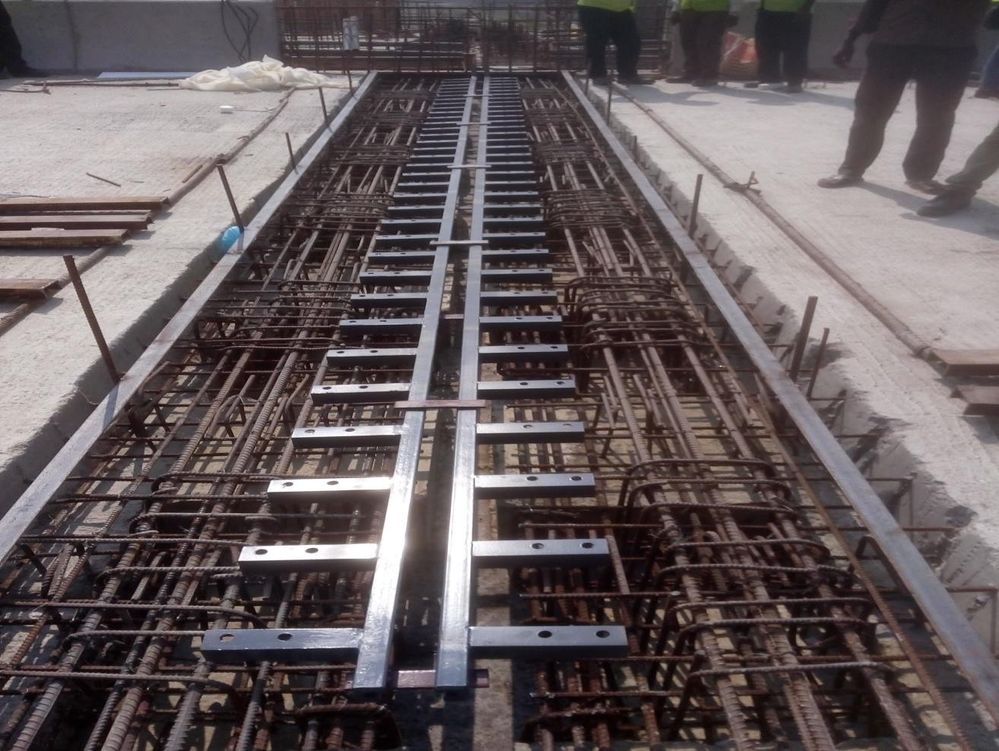
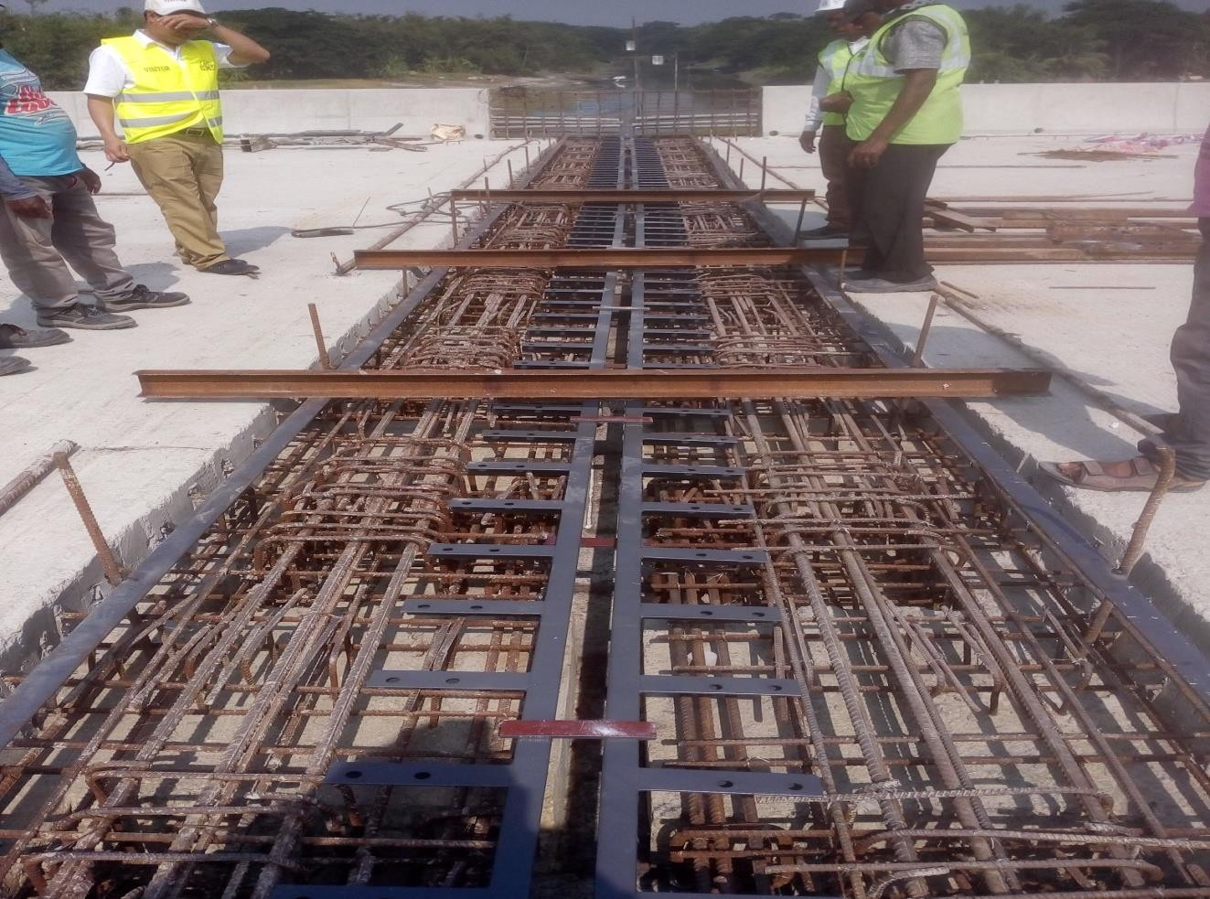
Placing Steel Profile Sealer Strip
Placing Cross Beam for level adjustment of Steel Profile

Slide 18



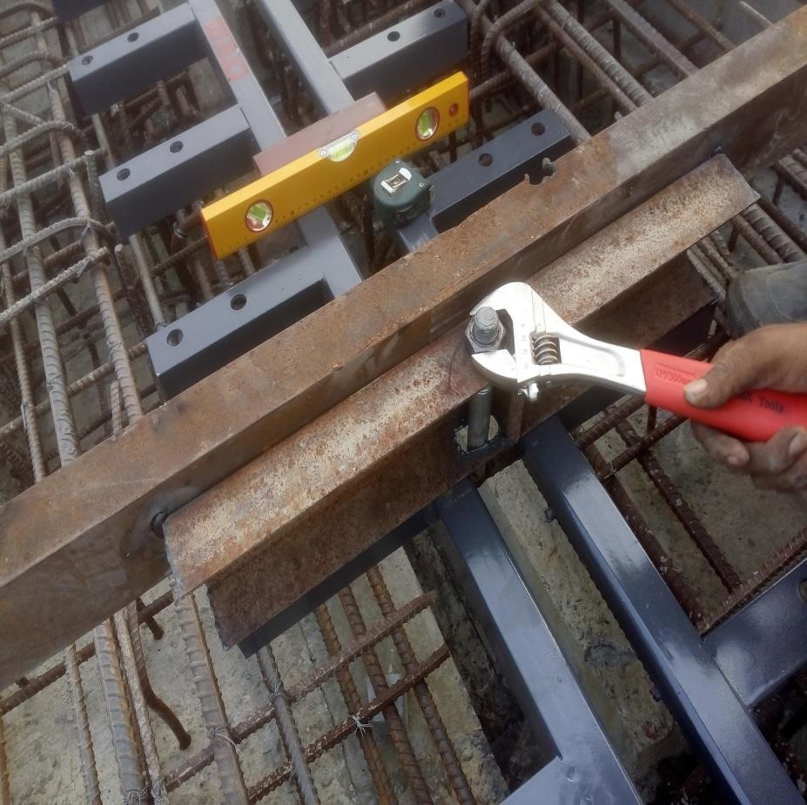
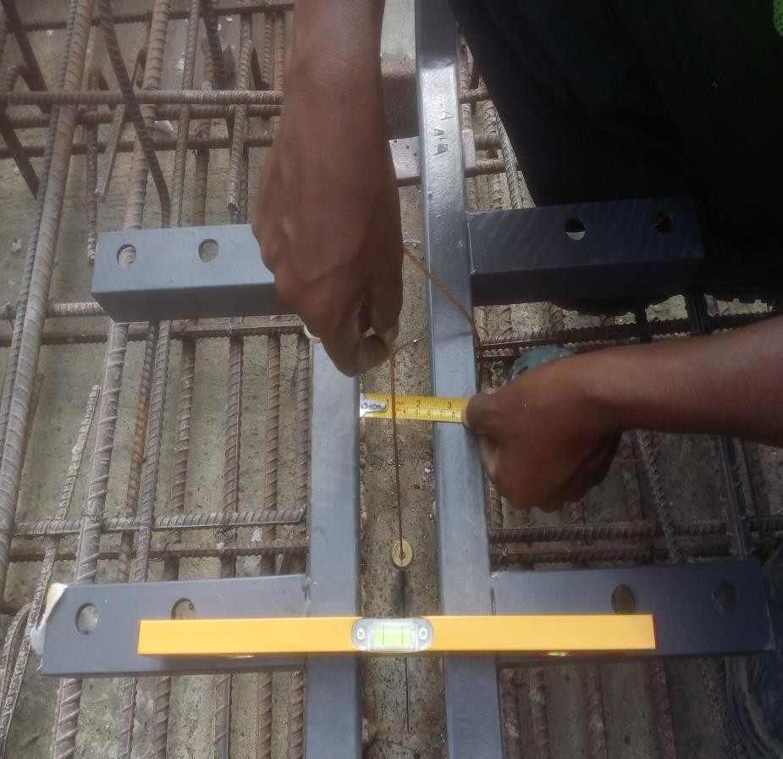
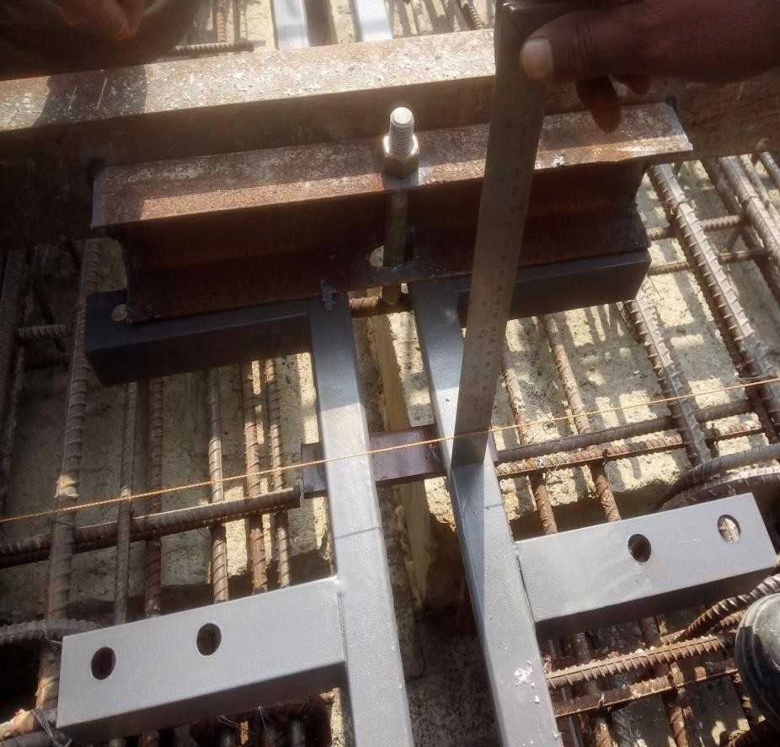
Level adjustment
Center line checking
Level checking

Slide 19



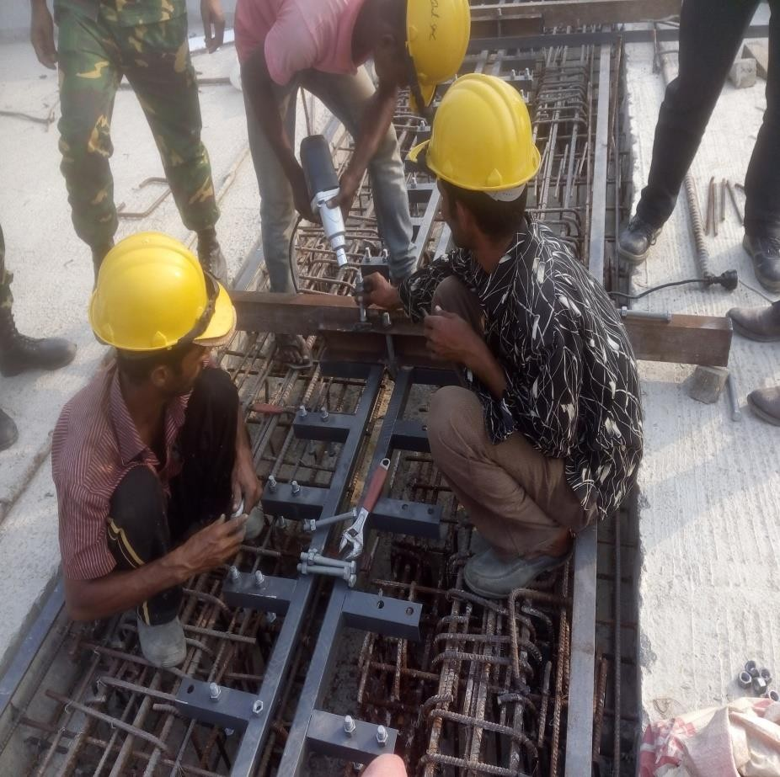
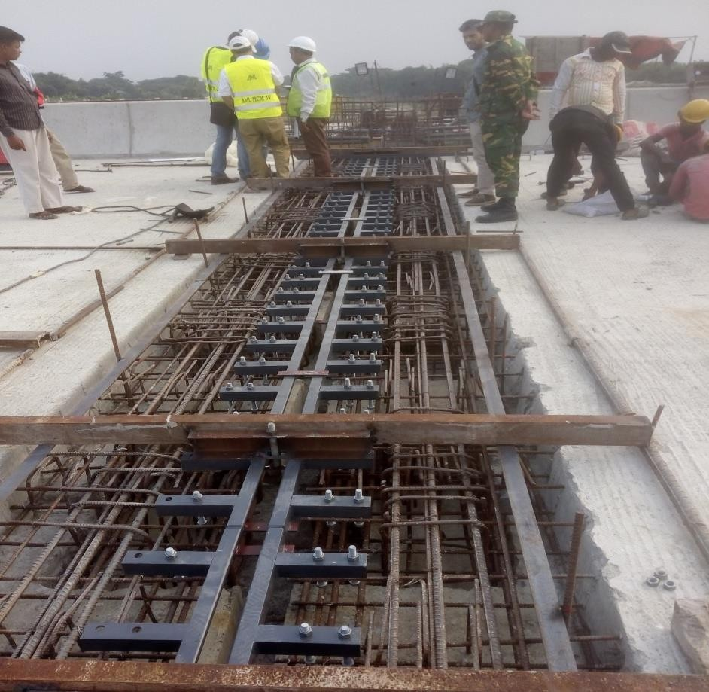
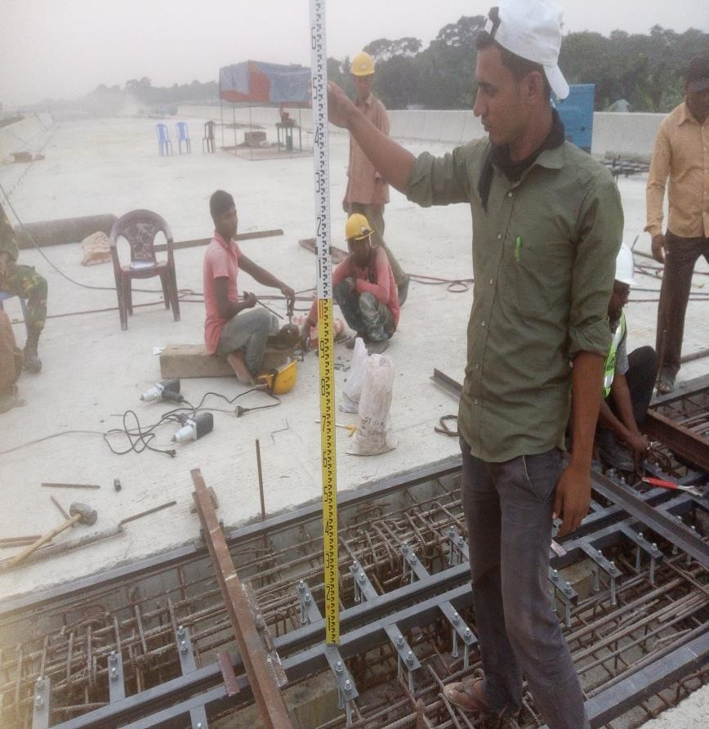
Installing of Anchor Bolt
After installation Anchor Bolt
Final Level checking by Level Machine

Slide 20


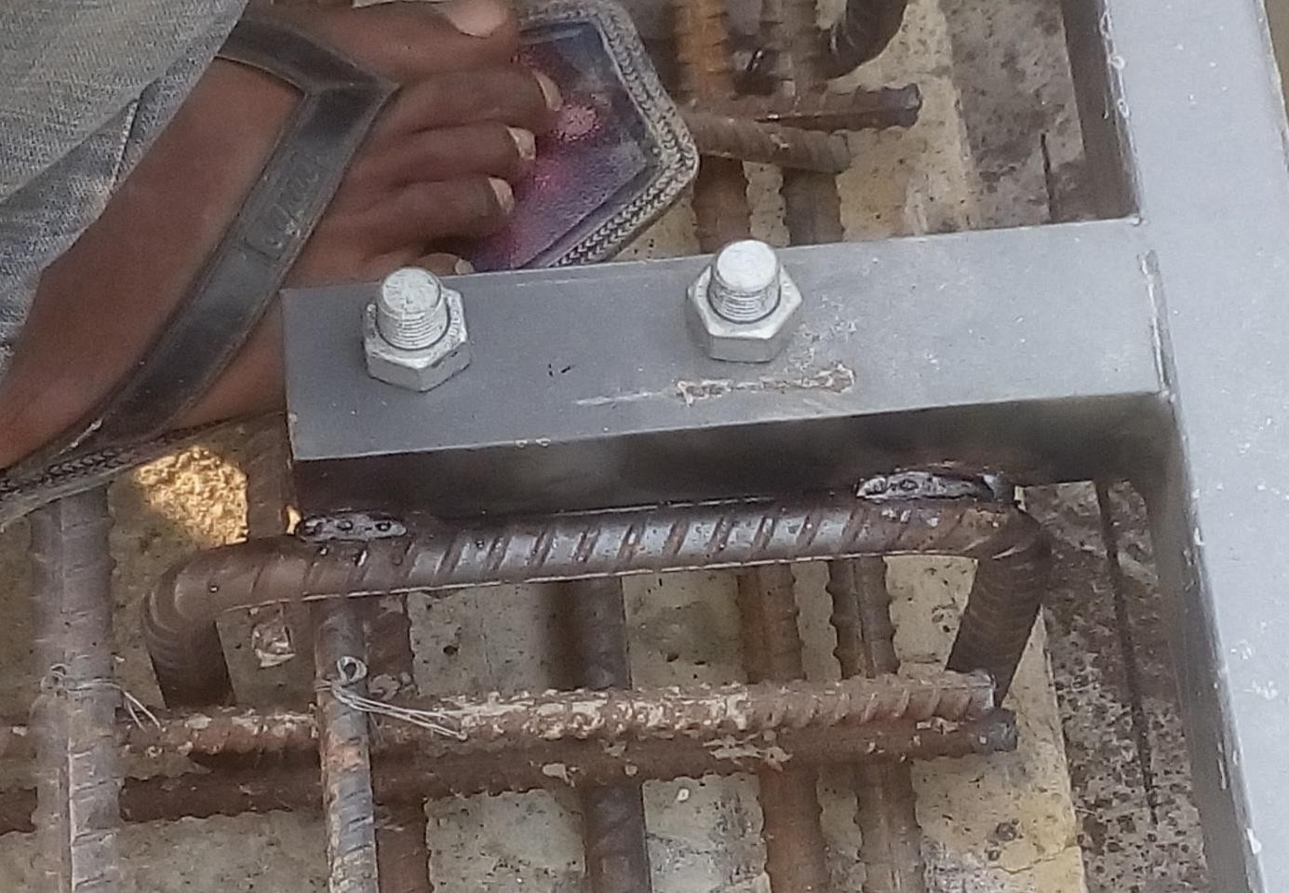
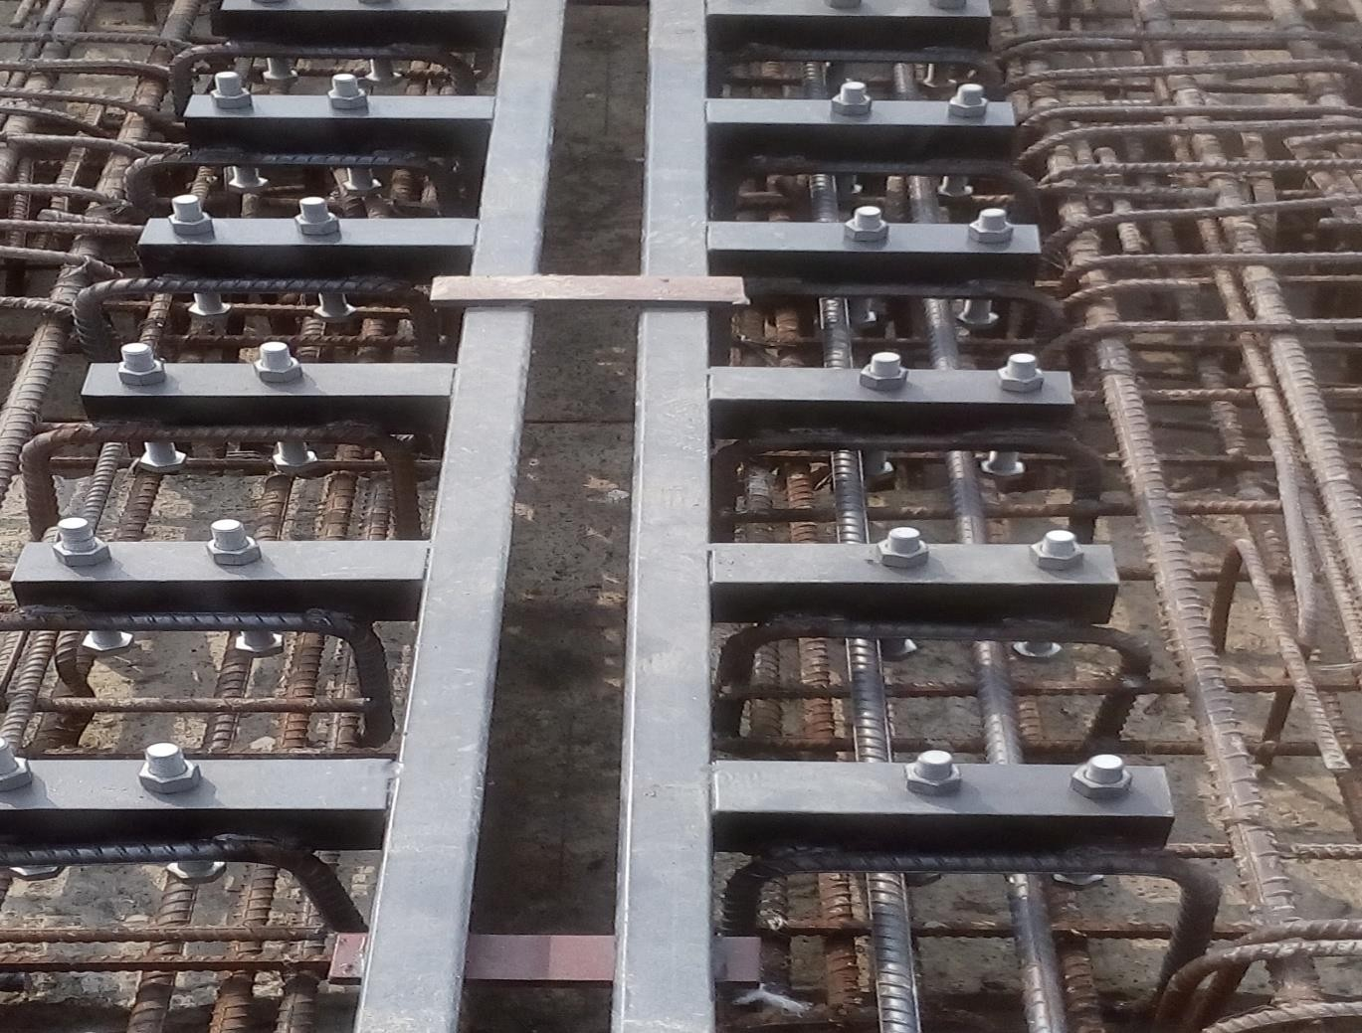
Welding of rectangular anchor bar with Steel Profile
After installation and welding of anchor bar

Slide 21


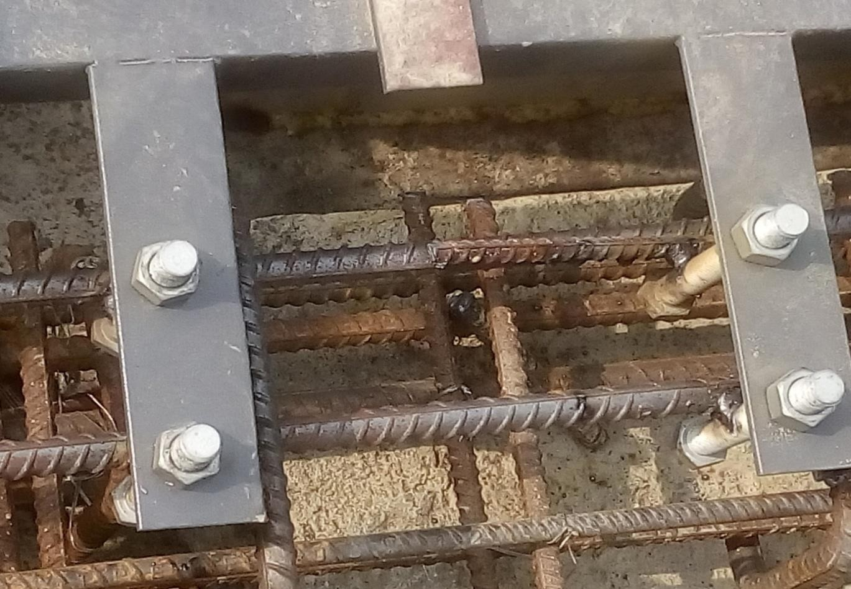
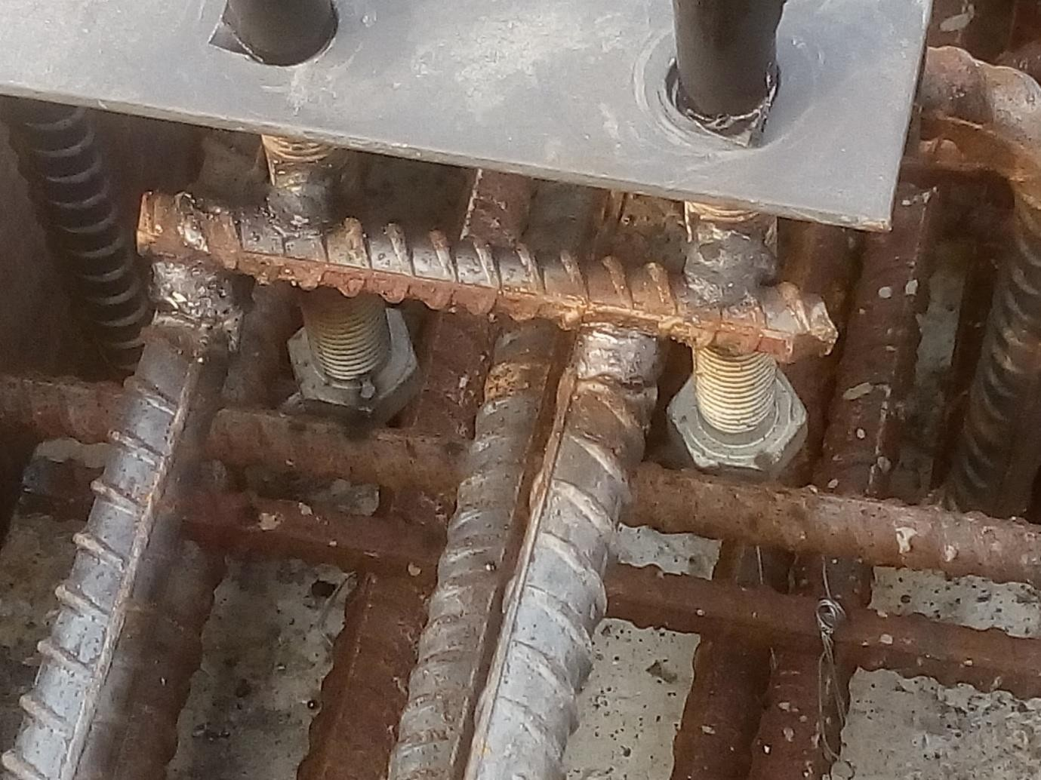
Welding Anchor Bolt with anchor Rebar
Welding extra cut piece rebar with Anchor Bolt & anchor Rebar

Slide 22



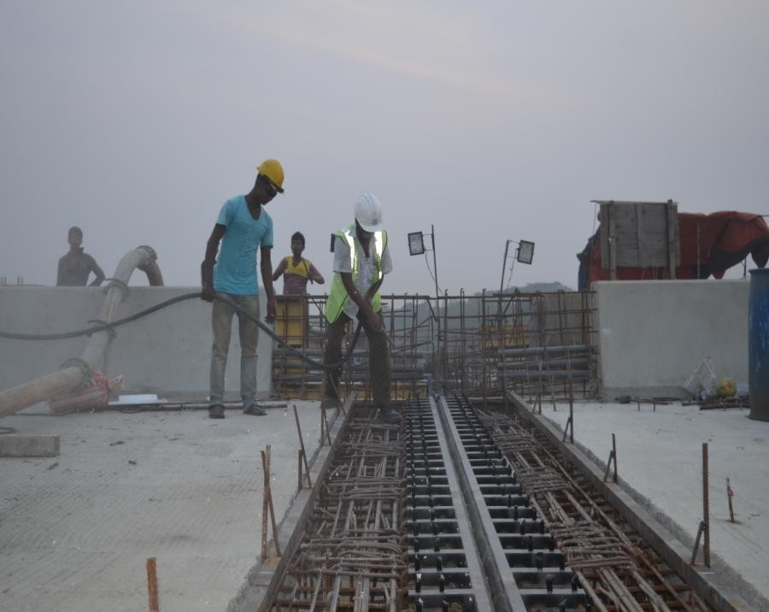
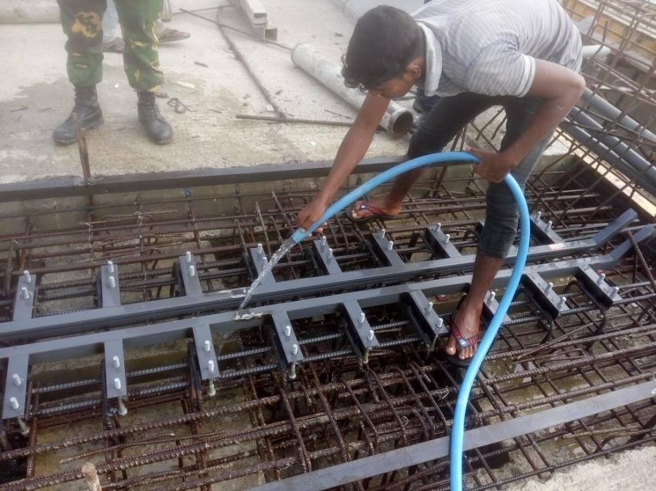
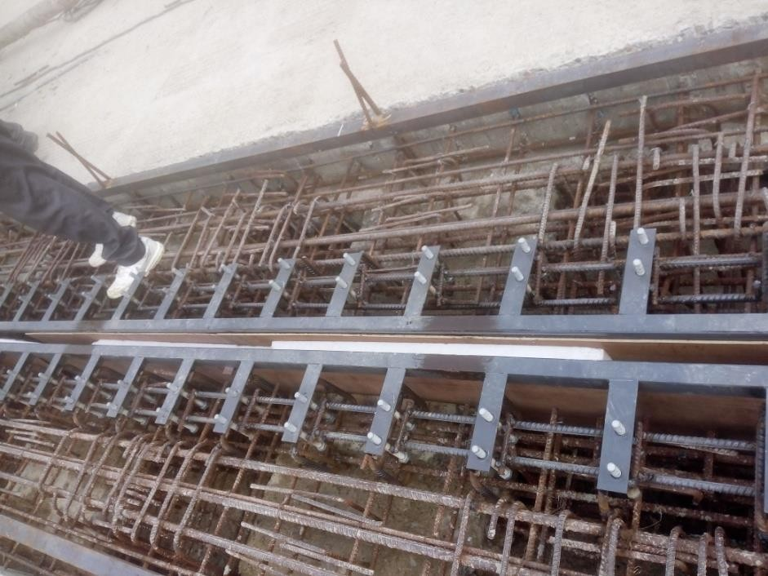
Cleaning by Air Compressor
Cleaning by Water
Formwork placing for Expansion Gap

Slide 23


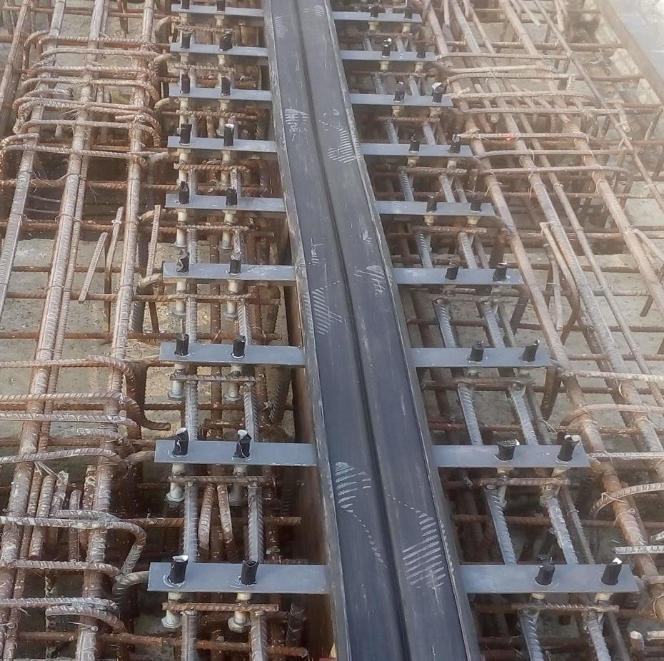
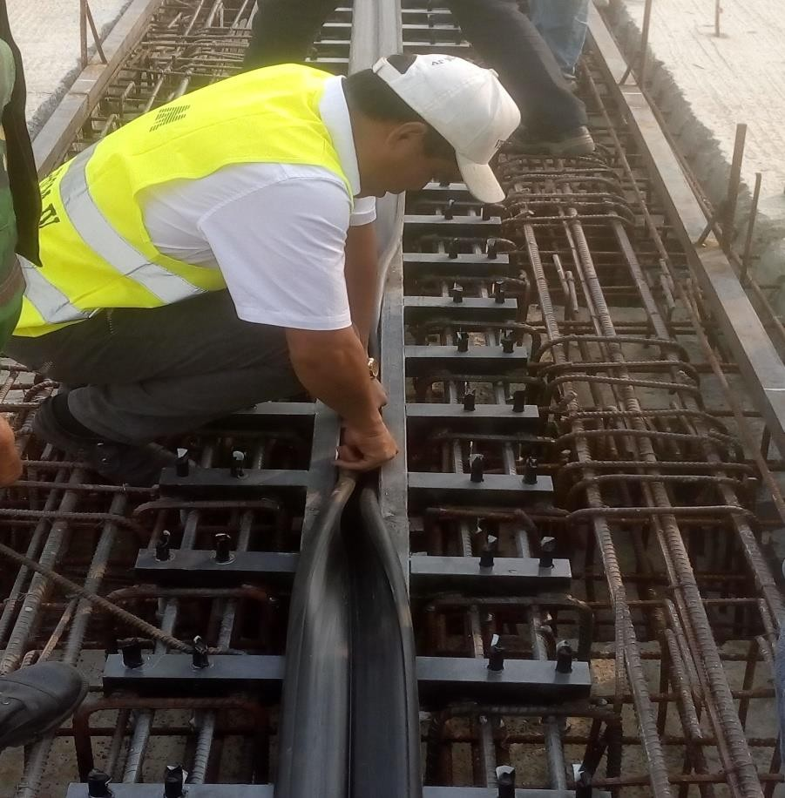
Rubber Seal placing on Steel Profile
Rubber Seal installation by hand

Slide 24


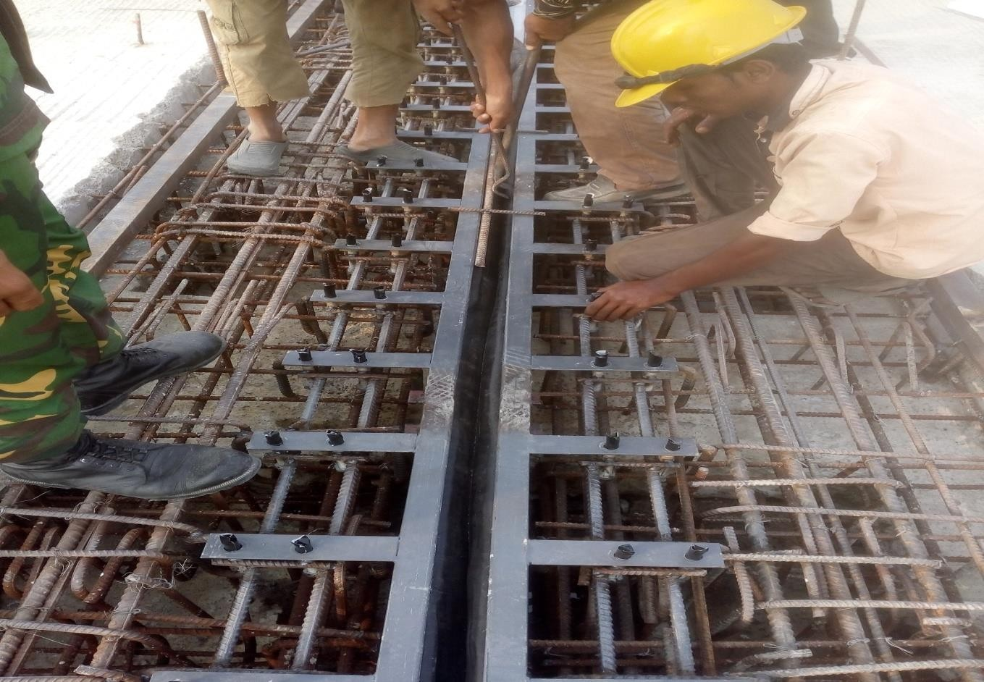
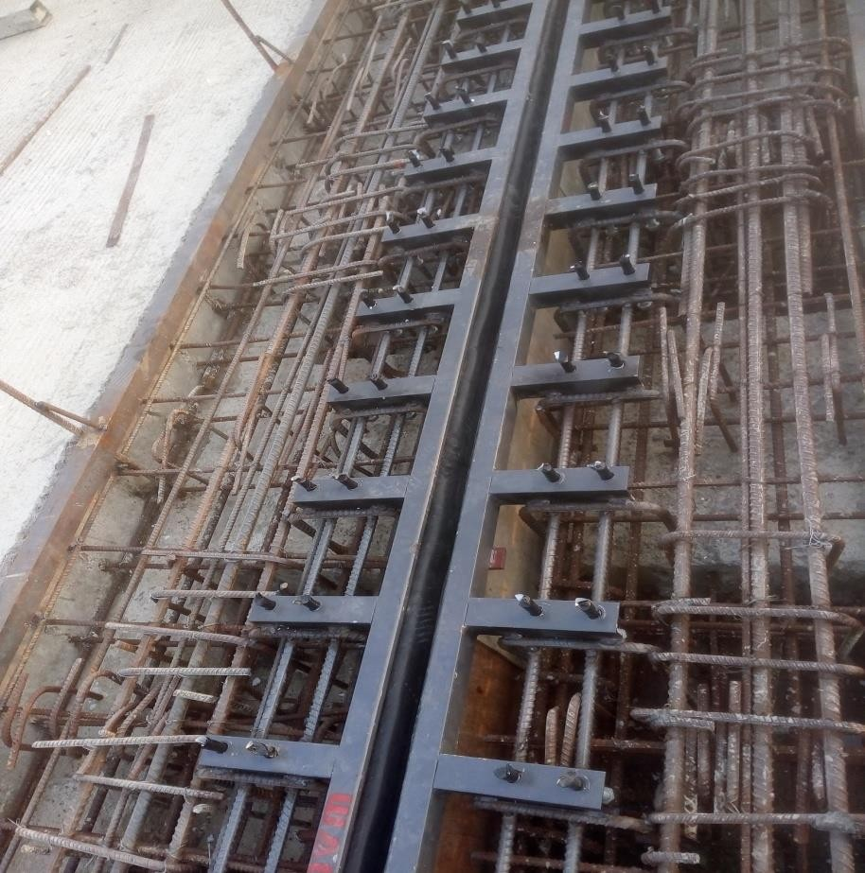
Rubber Seal installation by Crowbar
After installation Rubber Seal

Slide 25


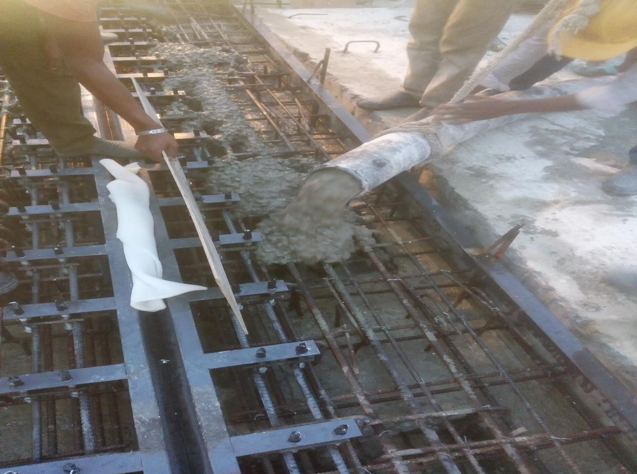
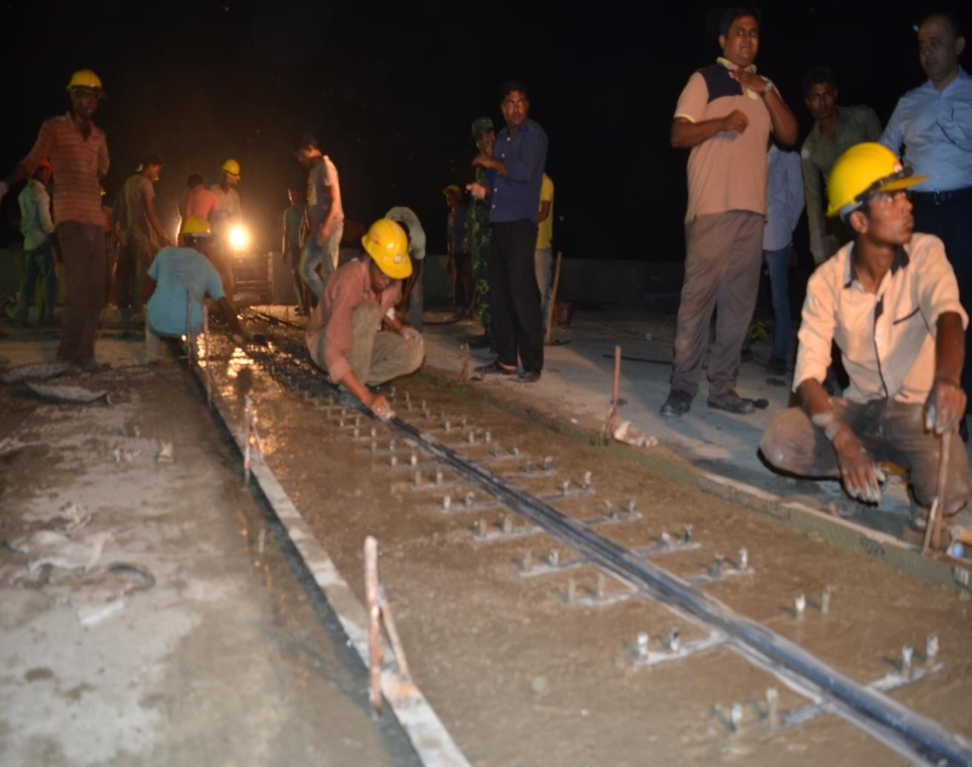
Concreting in Block-out area (Concrete Class C-50)
Concreting up to the level of Steel Profile

Slide 26



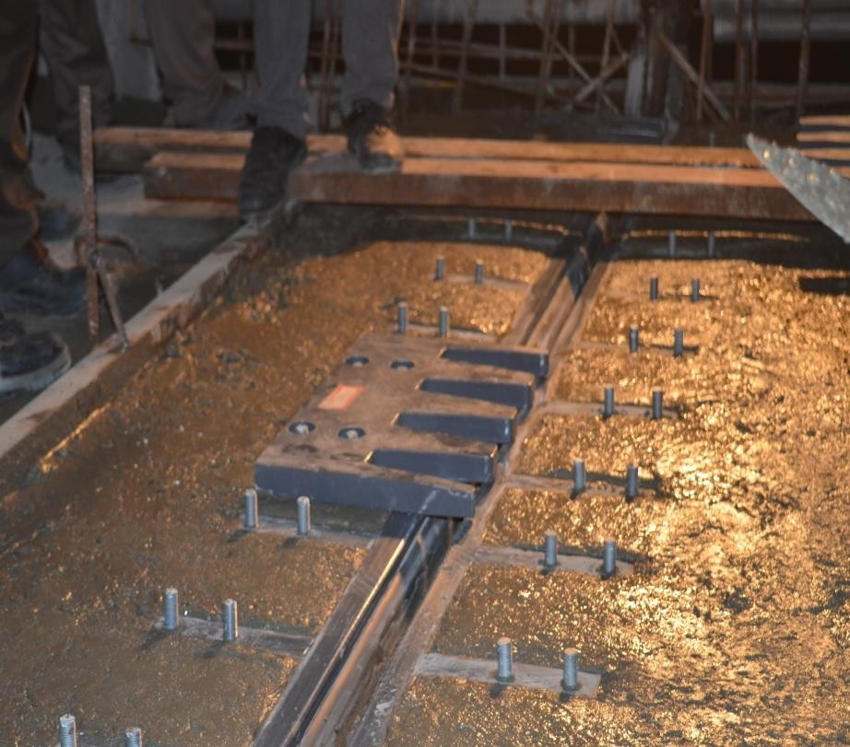
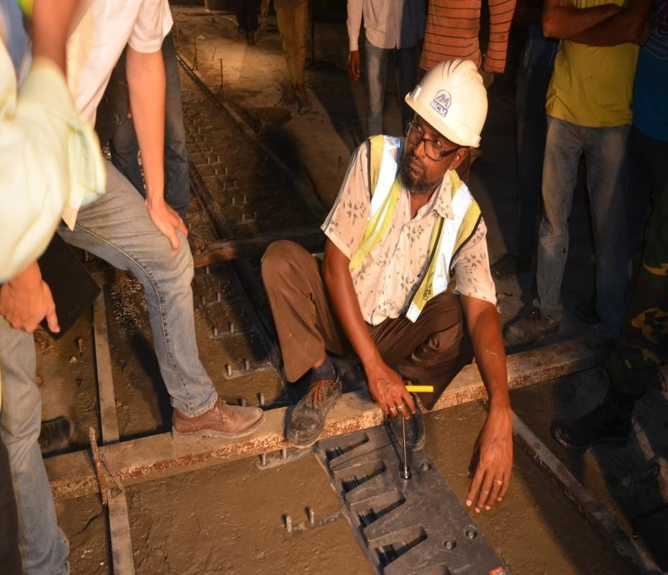
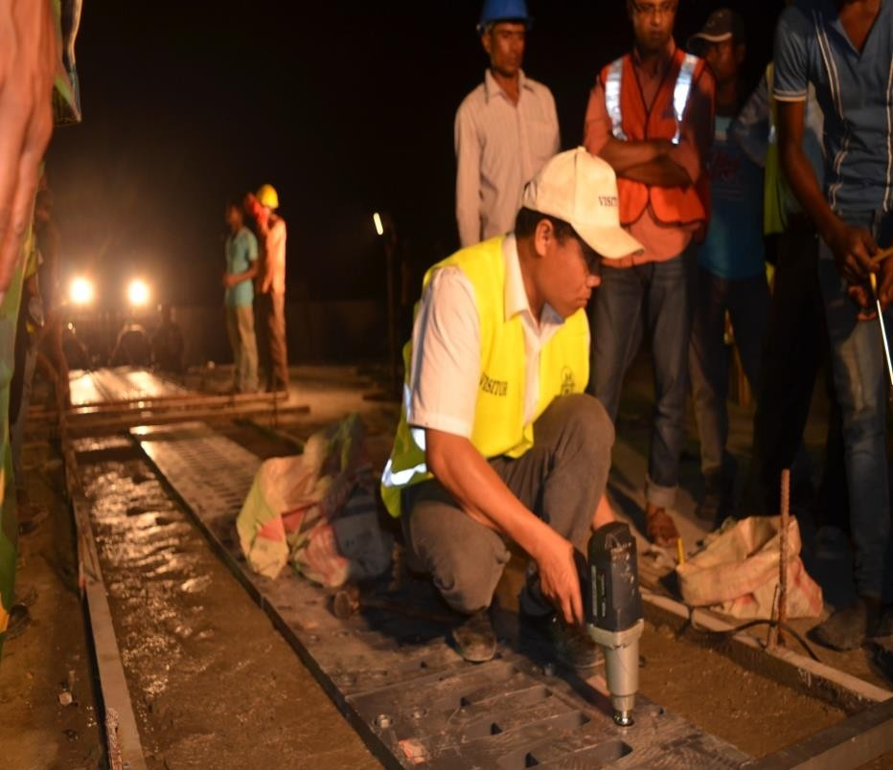
Placing Finger Plate
Tightening Anchor Bolt by Hand
Wrench
Tightening Anchor Bolt by Electric Wrench

Slide 27


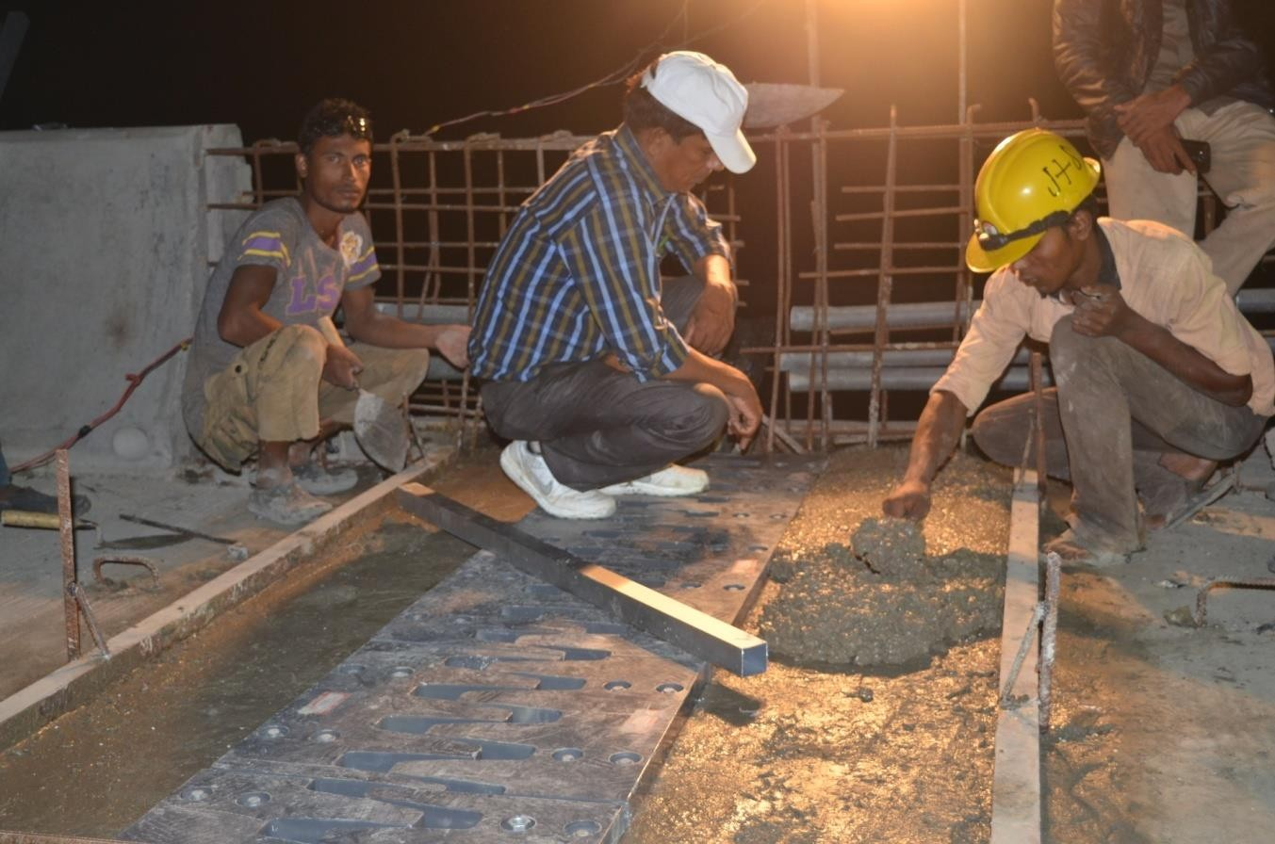
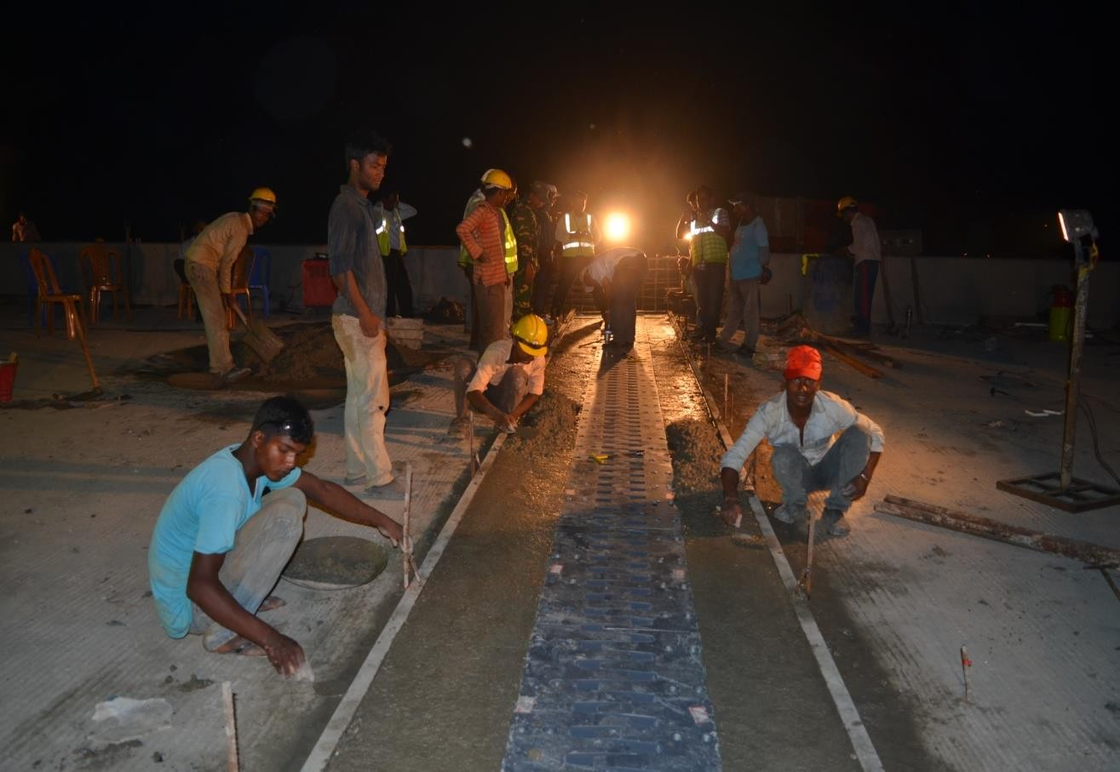
Concreting up to the level of Finger Plate

Slide 28


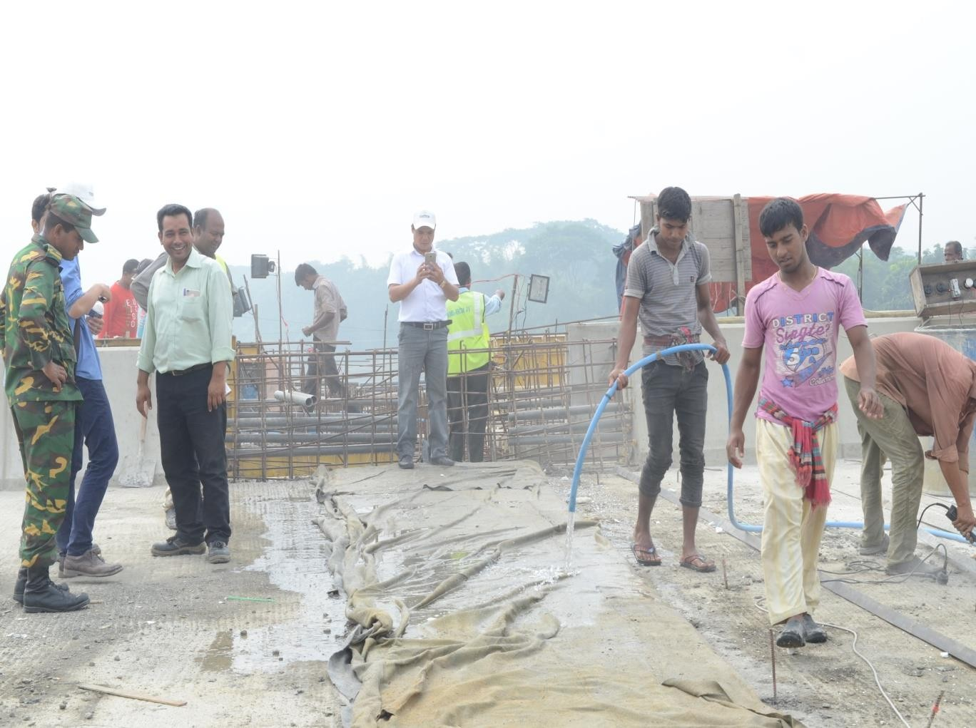
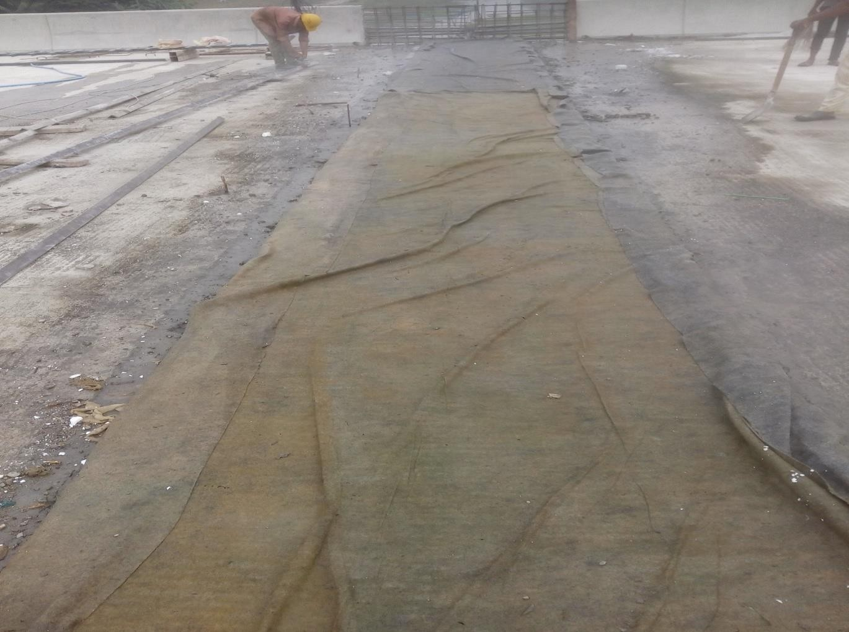
Curing

Slide 29

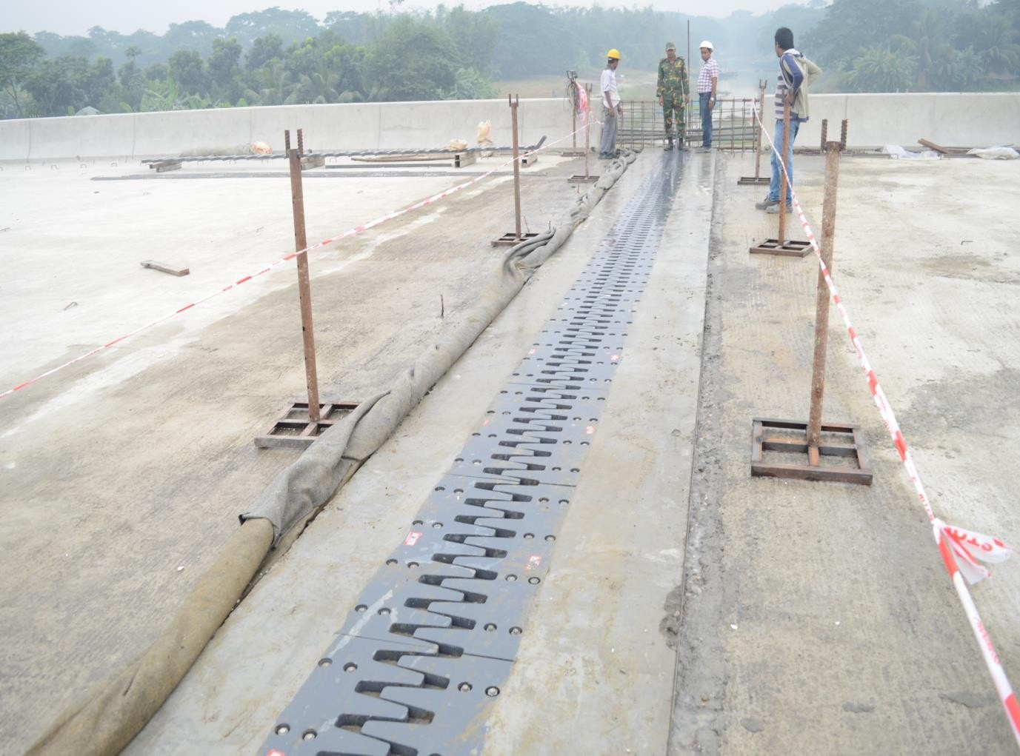
After complete Installation

Slide 30
CONTRACTION JOINT

Slide 31

WHY USED?
Contraction Joint is used to reduce the number of expansion joint,
thereby reducing cost and increasing driving comfort .
It allows only contraction of deck slab while the expansion joint allows
both expansion and contraction.

Slide 32
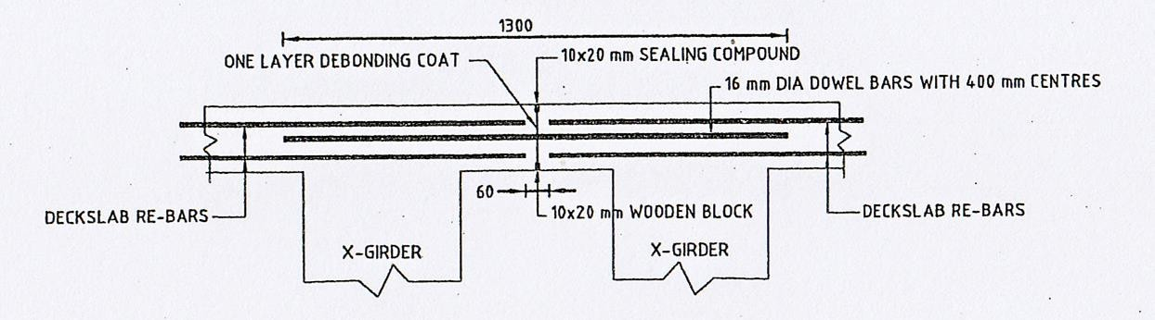
DESIGN OF CONTRACTION JOINT

Slide 33


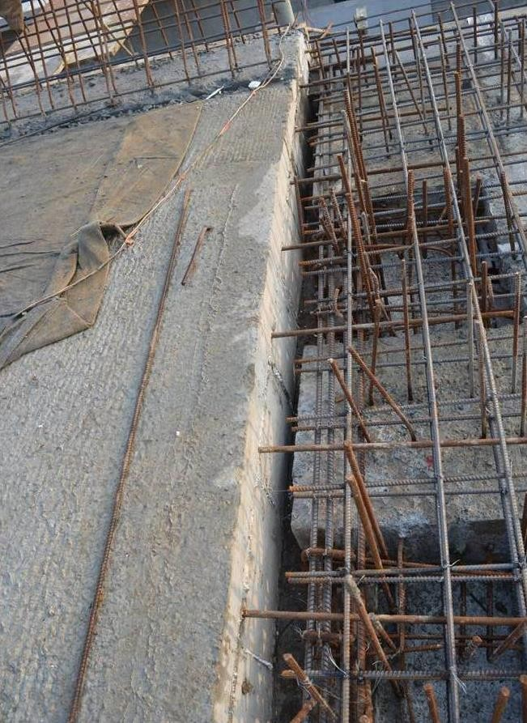
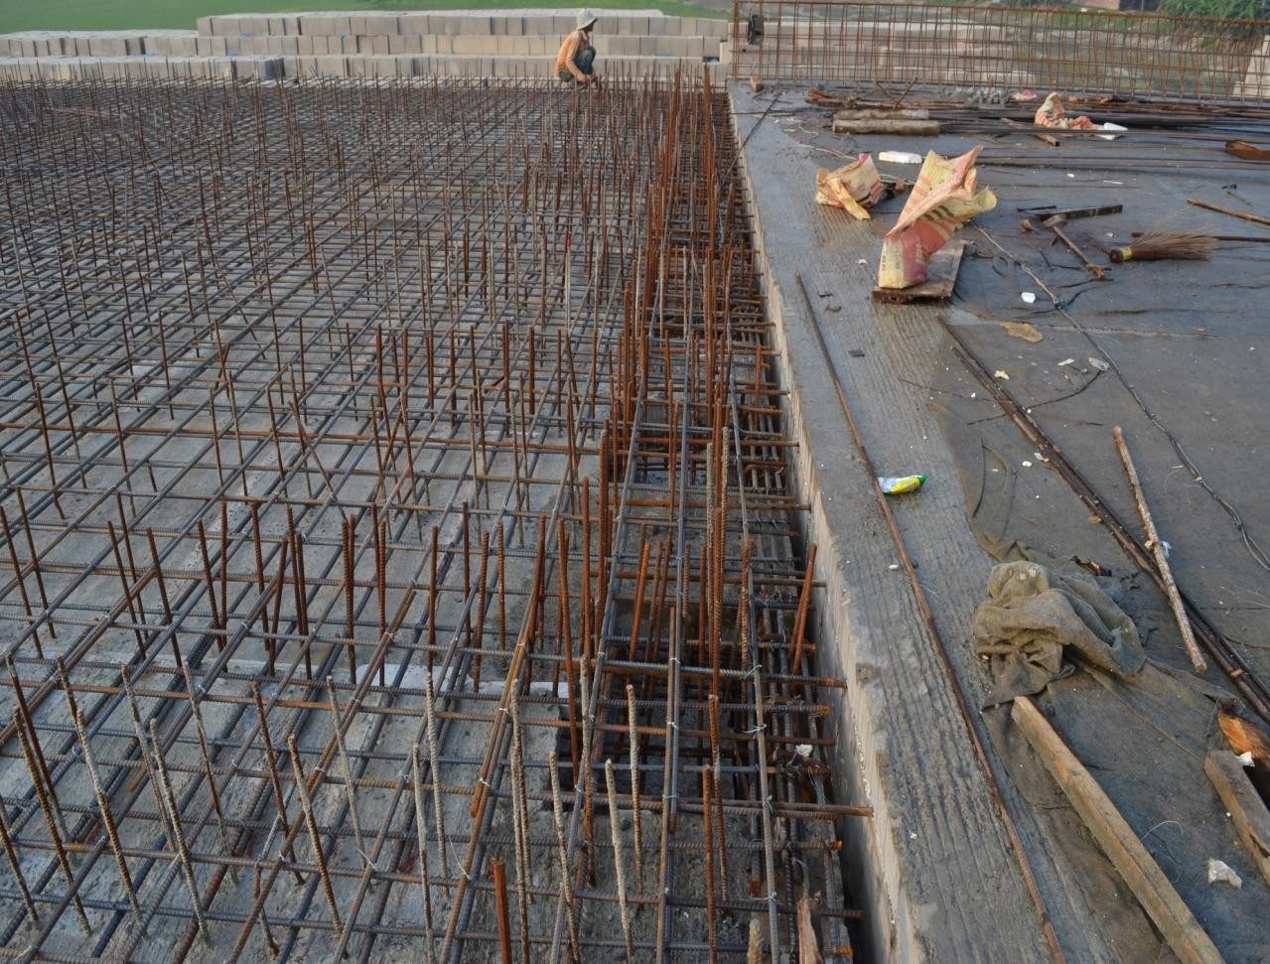








Dowel Bars
Contraction Joint after concreting deck slab(one side)
Debonding coat will be provided at dowel bars before concreting adjacent deck slab

Slide 34

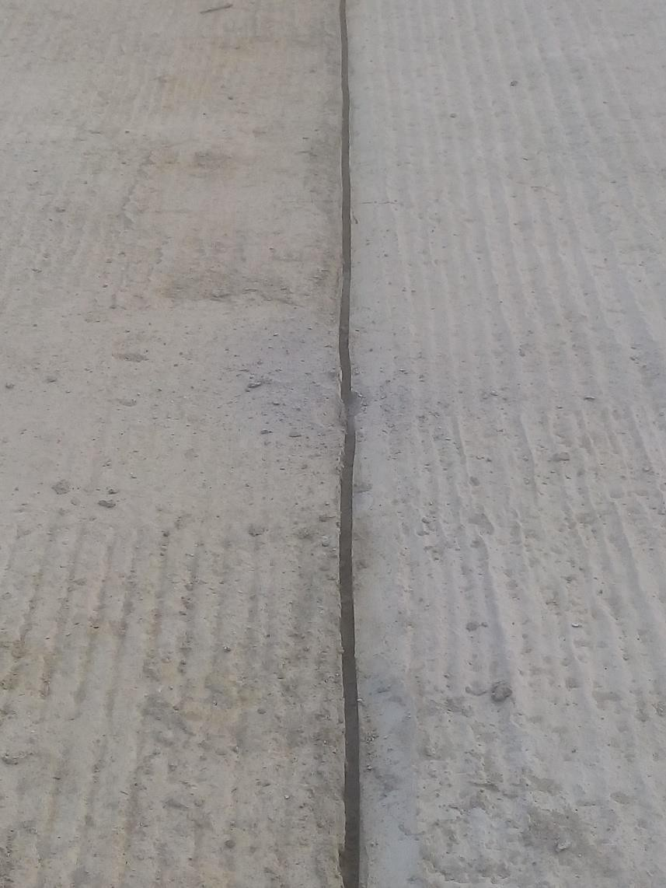
Sealing compound will be provided in this gap (10x20 mm)

